Slide 1
CSE 465 Lecture 9-2
Working Process 2

Slide 2
How to work on the project?
Deep Learning is a very empirical process
It relies on running experiments and observing model performance more than having one go-to formula for success that fits all problems
We often have an initial idea for a solution, code it up, run the experiment to see how it did, and then use the outcome of this experiment to refine our ideas
When building and tuning a neural network we try to resolve the following questions:
What is a good architecture to start with?
How many hidden layers should we stack?
How many hidden units or filters should go in each layer?
What is the learning rate?
Which activation function should we use?
Which yields better results, getting more data or tuning hyperparameters?

Slide 3

Defining performance metrics: Accuracy
Performance metrics allow us to evaluate our system
When we develop a model, we want to find out how well it is working
The simplest way to measure the “goodness” of our model is by measuring its accuracy
The accuracy metric measures how many times our model made the correct prediction
So, if we test the model with 100 input samples, and it made the correct prediction 90 times, this means the model is 90% accurate

Slide 4
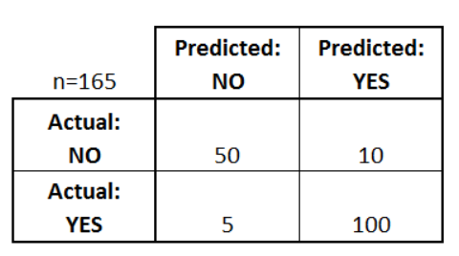
Confusion matrix & related scores
A confusion matrix is a table that is often used to describe the performance of a classification model (or "classifier") on a set of test data for which the true values are known
What can we learn from this matrix?
There are two possible predicted classes: "yes" and "no“
If we were predicting the presence of a disease, for example, "yes" would mean they have the disease, and "no" would mean they don't have the disease
The classifier made a total of 165 predictions (e.g., 165 patients were being tested for the presence of that disease)
Out of those 165 cases, the classifier predicted "yes" 110 times, and "no" 55 times
In reality, 105 patients in the sample have the disease, and 60 patients do not
Notes:
https://www.dataschool.io/simple-guide-to-confusion-matrix-terminology

Slide 5
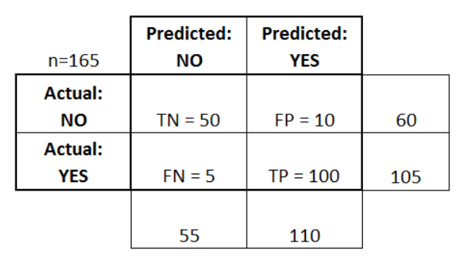
Confusion matrix terms
True Positives (TP): These are cases in which we predicted yes (they have the disease), and they do have the disease
True Negatives (TN): We predicted no, and they don't have the disease
False Positives (FP): We predicted yes, but they don't actually have the disease. (Also known as a "Type I error.")
False Negatives (FN): We predicted no, but they actually do have the disease. (Also known as a "Type II error.")

Slide 6
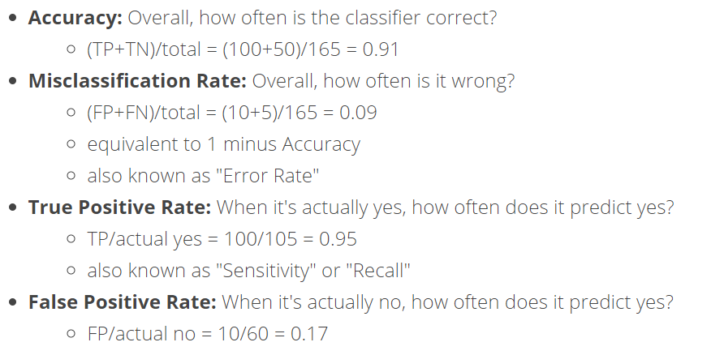
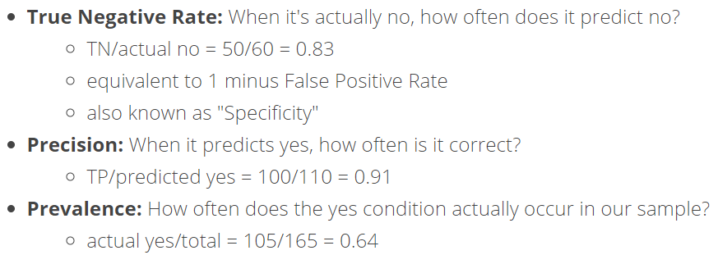
Confusion matrix other terms

Slide 7

Recall
Recall is the rate of correctly identifying the sick patients among all sick patients
In other words, on average how many times did the model correctly diagnose a sick patient as positive
More related to the positives of the actual dataset
Recall is calculated by the following equation

Slide 8

Precision
It tells us how often the identification of sick patients are correct
In other words, how many times did the model’s positive diagnose of a patient as sick is correct
More related to the positive identification of the model
Precision is calculated by the following equation:

Slide 9

F-score
In many cases, we want to summarize the performance of a classifier with a single metric that represents both recall and precision
To do so, we can convert precision (p) and recall (r) into a single F-score metric
In mathematics, this is called the harmonic mean of p and r:

Slide 10
Using the appropriate metrics
Although in these examples of health diagnostics we decided that recall is a better metric, other use cases require different metrics, like precision
To identify the most appropriate metric for our problem, we need to think which one is more important
False positive
Then we are looking for precision
False negative
Then we are looking for recall
Consider a spam email classifier
Which of the two false predictions would be more appropriate?
Falsely classifying a non-spam email as spam, in which case it gets lost?
Falsely classifying a spam email as non-spam, after which it makes its way to the inbox folder?
Common sense tells us to choose the second case (FP)
We don’t want the receiver to lose an email because the model misclassified it as spam
We want to catch all spam, but it is very bad to lose a non-spam email
For email classifier precision is a more suitable metric to use
In some applications, we might care about both precision and recall at the same time
That’s the case for an F-score
Notes:
https://www.analyticsvidhya.com/blog/2020/09/precision-recall-machine-learning/

Slide 11
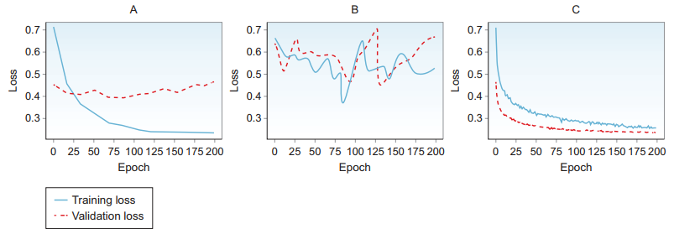
Plotting the learning curve
Looking at training output and comparing numbers is a cumbersome job
A better way is to check the plots of training and validation errors
Plot A below shows that the network improves the loss value on the training data but fails to generalize on the validation data
Learning on the validation data progresses in the first couple of epochs and then flattens out and maybe decreases
This is a form of overfitting
Note that this graph shows that the network is actually learning on the training data, a good sign that training is happening
So we don’t need to add more hidden units, nor do you need to build a more complex model
If anything, network is too complex for the data, because it is learning so much that it is actually memorizing the data and failing to generalize to new data
In this case the next step might be to collect more data or apply techniques to avoid overfitting

Slide 12
Plotting the learning curve
Figure B shows that the network performs poorly on both training and validation data
In this case the network is not learning
We don’t need more data, because the network is too simple to learn from the data
Next step is to build a more complex model
Figure C shows that the network is doing a good job of learning the training data and generalizing to the validation data
This means there is a good chance that the network will have good performance out in the wild on test data.

Slide 13
Parameters vs Hyperparameters
Hyperparameters are the variables that we set and tune
Parameters are the variables that the network updates using the optimization algorithm (gradient descent)
They are learned and updated by the network during training, and we do not adjust them
In neural networks, parameters are the weights and biases that are optimized automatically during the backpropagation process
In contrast, hyperparameters are variables that are not learned by the network
They are set by the ML engineer before training the model and then tuned
These are variables that define the network structure and determine how the network is trained
Hyperparameter examples include learning rate, batch size, number of epochs, number of hidden layers, etc.

Slide 14
Hyperparameters
We can categorize neural network hyperparameters into three main categories:
Network architecture
Number of hidden layers (network depth)
Number of neurons in each layer (layer width)
Activation type
Learning and optimization
Learning rate and decay schedule
Mini-batch size
Optimization algorithms
Number of training iterations or epochs (and early stopping criteria)
Regularization techniques to avoid overfitting
L2 regularization
Dropout layers
Data augmentation

Slide 15
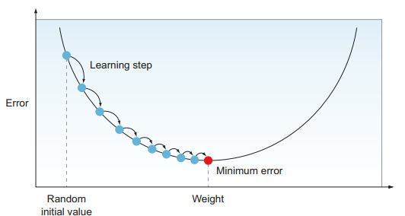
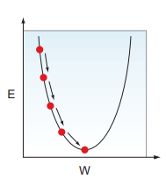
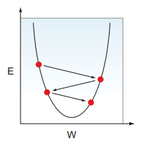
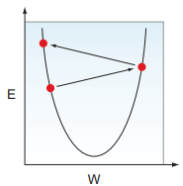
Learning rate
The GD optimizer searches for the optimal values of weights that yield the lowest error possible
When setting up our optimizer, we need to define the step size that it takes when it descends the error mountain
This step size is the learning rate
It represents how fast or slow the optimizer descends the error curve

Slide 16
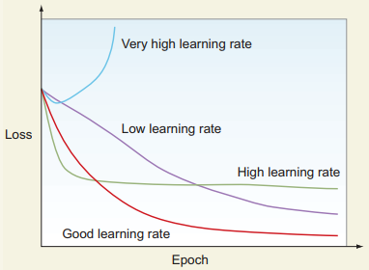
Setting the learning rate
Setting the learning rate high or low is a trade-off between the optimizer speed versus performance
Too-low lr requires many epochs to converge
Too-high lr might get us to a lower error value faster because we take bigger steps down the error curve, but there is a better chance that the algorithm will oscillate and diverge away from the minimum value
So, ideally, we want to pick the lr that is just right (optimal): it swiftly reaches the minimum point without being so big that it might diverge

Slide 17
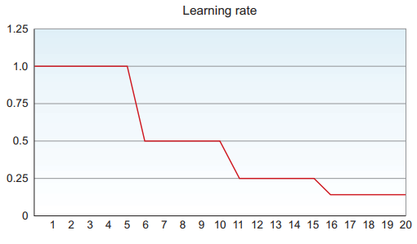
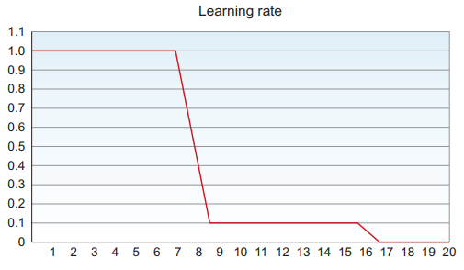
Adaptive learning rate
Finding the learning rate value that is just right for a problem is an iterative process
We start with a static lr value, wait until training is complete, evaluate, and then tune
Another way to go about tuning your learning rate is to set a learning rate decay: a method by which the learning rate changes during training
It often performs better than a static value, and drastically reduces the time required to get optimal results

